Slide 1



International Conference on Power, Electronics, Communications, Computing, and Intelligent Infrastructure 2026 (PECCII 2026)
Paper ID – 521
Robust, Explainable Cross-Dataset Deepfake Video Detection:
Attention-Pooled Face Sequences with Compression-Aware
UDA-DANN and Interactive GUI
Md. Siam Uddin Molla Antor, Ittihad Hasnat Tayesh, Mohammad Ali Sakib, Nitun Kumar Podder, Ishrat Khan
Presented by Md. Siam Uddin Molla Antor (1st Author & Presenter)
Dept. of CSE, Pabna University of Science and Technology, Pabna-6600 · Khulna Agricultural University, Khulna-9100, Bangladesh
17–18 June 2026

Slide 2
Table of Contents
01
Introduction & Motivation
07
Explainability — Temporal Attention & Grad-CAM
02
Methodology & System Pipeline
08
Interactive GUI Deployment
03
Dataset Description
09
Comparison with Prior Work
04
Results — Cross-Dataset Performance
10
Limitations
05
Results — ROC Curves (CelebDF-v2, FF++, Holdout)
11
Future Work
06
Results — Ablation Study (FF++ Final500)
12
References

Slide 3
Introduction & Motivation
🎭 The Deepfake Problem
📉 Cross-Dataset Degradation
🔬 Our Solution
Modern face manipulation models create hyper-realistic forged videos — threatening digital trust, enabling misinformation and identity theft.
Supervised detectors achieve high accuracy on benchmarks but drop sharply on unseen datasets due to compression artifacts and domain-specific biases.
Attention-pooled face sequences + UDA-DANN domain alignment + compression-aware augmentation + Grad-CAM explainability + interactive GUI.
🏆 Best Result: UDA-DANN + CompAug achieves F1 = 0.868, Acc = 0.774 on FF++ C23 Final500 under strict Calib→Test protocol

Slide 4
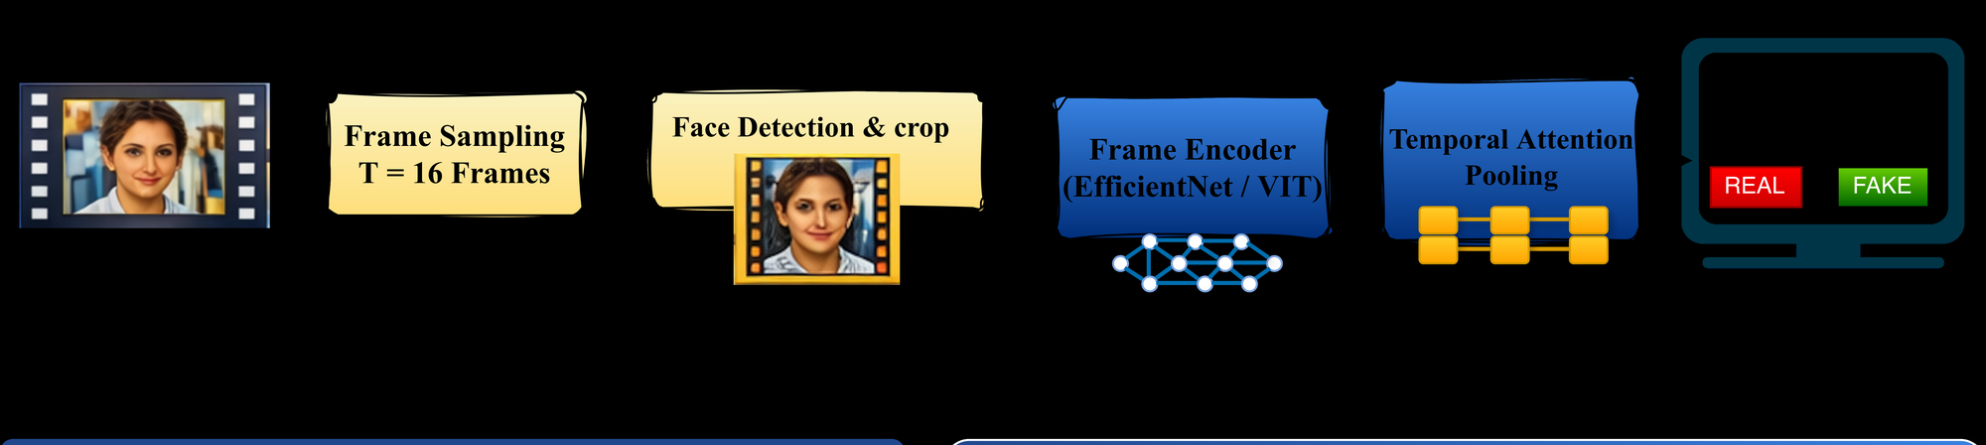
Methodology — System Pipeline
A
B
C
D
E
Frame Sampling
Face Detection
Frame Encoding
Attention Pooling
Classification
T=16 frames uniformly sampled per video
Dominant face detected, cropped & aligned to 224×224
EfficientNet-B1 backbone → frame embeddings hₜ
Softmax attention weights αₜ → video-level vector v
Binary cross-entropy prediction: REAL / FAKE

Slide 5
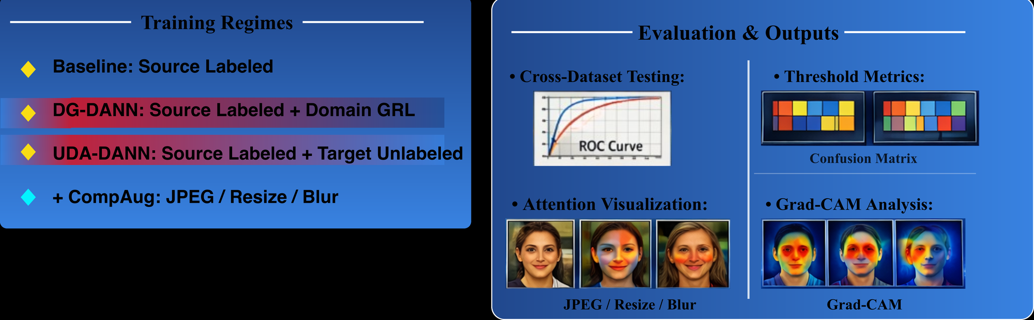
Methodology — UDA-DANN & Compression-Aware Augmentation
🔄 UDA-DANN Domain Alignment
🗜️ Compression-Aware Augmentation
• Gradient Reversal Layer (GRL) trains domain-invariant features
• Uses unlabeled FF++ target videos to reduce domain shift
• Objective: L_UDA = L_cls(source) + λ · L_dom(source ∪ target)
• JPEG re-encoding with varying quality factors
• Random down/up-sampling to simulate encoding artifacts
• Mild blur — mimics real-world deployment compression

Slide 6
Dataset Description
🎬
Primary benchmark. Multiple manipulation types + standard compression configs (RAW / C23 / C40). Tests robustness under compression artifacts.
1,000
Real
4,000
FaceForensics++ (FF++)
Fake
5,000
Source + Target (UDA)
Total
⭐
High-fidelity in-the-wild deepfakes. Closer to real-world scenarios. Reveals cross-dataset generalization failures in most detectors.
890
Real
5,639
CelebDF-v2
Fake
6,529
Cross-dataset Test
Total
🔍
Balanced source domain dataset for training. Provides labeled real/fake pairs for supervised baseline and UDA source training.
363
Real
3,068
DFD (DeepFakeDetection)
Fake
3,431
Labeled Source Train
Total

Slide 7
Results — Cross-Dataset Performance (τ = 0.5)
Model | Dataset | AUC | Acc | Prec | Rec | F1
DenseNet121 | CelebDF-v2 | 0.844 | 0.904 | 0.918 | 0.976 | 0.946
EffNet-B0 | CelebDF-v2 | 0.876 | 0.831 | 0.958 | 0.841 | 0.896
EffNet-B1 ★ | CelebDF-v2 | 0.902 | 0.911 | 0.943 | 0.954 | 0.949
ViT-B/16 | CelebDF-v2 | 0.799 | 0.818 | 0.929 | 0.855 | 0.890
DenseNet121 | FF++ C23 | 0.621 | 0.511 | 0.910 | 0.432 | 0.586
EffNet-B0 | FF++ C23 | 0.626 | 0.507 | 0.882 | 0.443 | 0.589
EffNet-B1 ★ | FF++ C23 | 0.647 | 0.518 | 0.888 | 0.455 | 0.601
ViT-B/16 | FF++ C23 | 0.610 | 0.477 | 0.881 | 0.401 | 0.551
★ EfficientNet-B1 shows the most consistent cross-dataset performance on both benchmarks — selected as default backbone

Slide 8
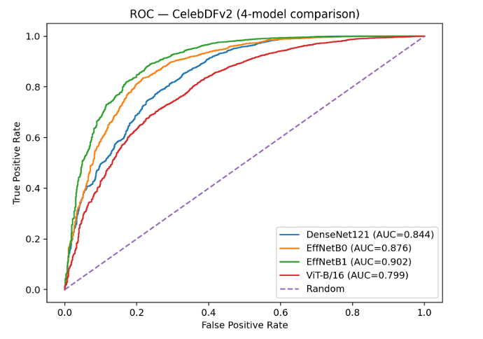
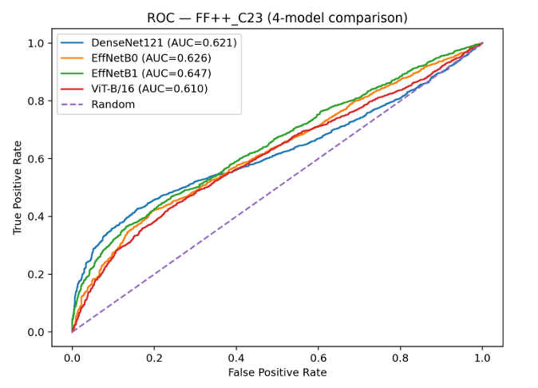
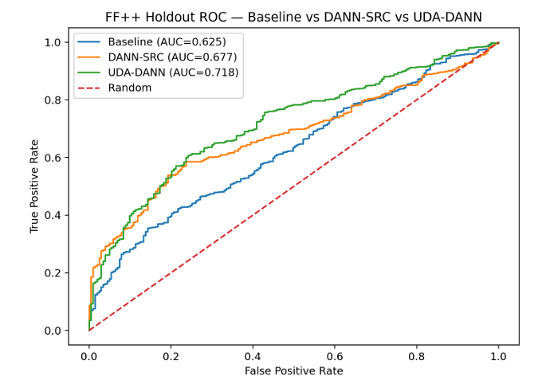
Results — ROC Curves (Cross-Dataset Evaluation)
ROC — CelebDF-v2
ROC — FF++ C23
ROC — FF++ Holdout (1000)
📈 Key Observations
⭐ CelebDF: EffNet-B1 achieves best AUC=0.902 — strong cross-dataset transfer
📊 FF++ C23 (source-only): AUCs 0.610–0.647 — all struggle with compression
🚀 Holdout: UDA-DANN improves AUC from 0.625 → 0.718 over baseline
✅ UDA-DANN curves shift upper-left — better TPR at same FPR

Slide 9
Results — Ablation Study (FF++ Final500, Strict Calib→Test Protocol)
Method | Acc | Prec | Rec | F1
Baseline (EffNet-B1) | 0.654 | 0.839 | 0.713 | 0.771
DANN-SRC (EffNet-B1) | 0.472 | 0.934 | 0.380 | 0.540
UDA-DANN (EffNet-B1) | 0.706 | 0.848 | 0.779 | 0.812
UDA-DANN + CompAug ★ | 0.774 | 0.830 | 0.909 | 0.868
🔬 Component Analysis
📌 Baseline: strong precision but poor recall — misses compressed fakes
⚠️ DANN-SRC: unstable — high precision (0.934) but very low recall (0.380)
📈 UDA-DANN: unlabeled target alignment improves recall +6.6% and F1 +2.7%
🏆 UDA-DANN + CompAug: best trade-off — recall 0.909, F1 0.868
💡 Both target alignment AND compression augmentation are essential for robustness
F1-Score Comparison
Baseline
0.771
DANN-SRC
0.540
UDA-DANN
0.812
UDA-DANN+CompAug
0.868

Slide 10
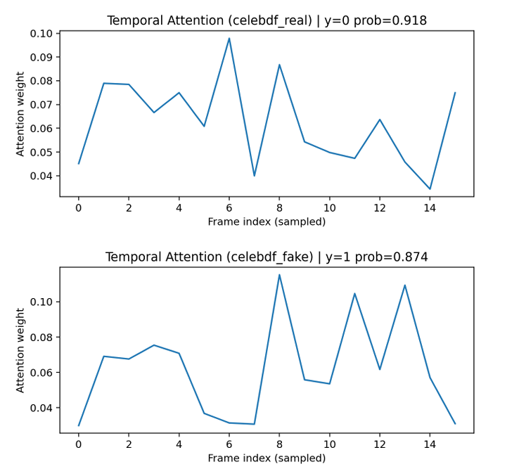
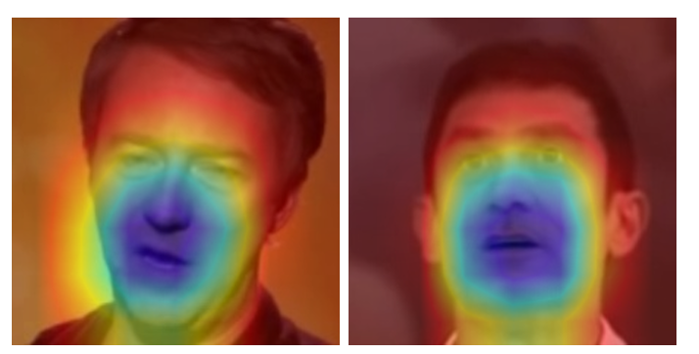
Explainability — Temporal Attention & Grad-CAM
Temporal Attention Weights
Grad-CAM Spatial Localization
🔍 Key Observations
🕐 Attention weights highlight the most informative temporal frames for the final prediction
🟥 Grad-CAM localizes manipulation artifacts on high-detail facial regions (eyes, mouth, boundaries)
⚠️ Failure cases occur at heavy compression, motion blur, occlusion, or poor face localization

Slide 11
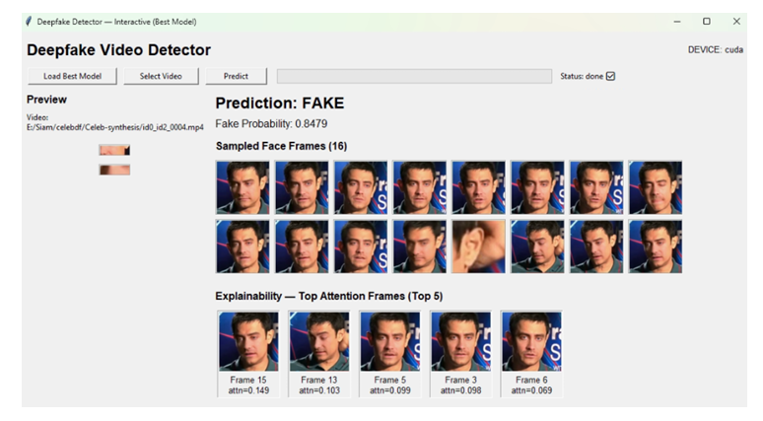
Interactive GUI Deployment
🖥️ GUI Features
📂 Load best model checkpoint with one click
🎬 Select any input video for inference
⚡ T=16 frame uniform sampling + face detection + EfficientNet-B1 encoding
🏷️ Displays prediction label (REAL/FAKE) and probability score
👀 Shows all 16 sampled face frames visually
📊 Top attention-weighted frames highlighted for interpretability
🔥 Grad-CAM overlays on key frames for spatial explanation

Slide 12
Comparison with Prior Work
(A) Prior Work — FF++ → CelebDF-v2 (AUC %)
(B) This Paper — FF++ C23 (Calib500 → Final500)
Method | AUC | Training
LipForensics [13] | 82.4 | Trained on FF++
RealForensics [18] | 86.9 | Trained on FF++
SBI [17] | 93.18 | Trained on FF++
M2TR [15] | 68.2 | FF++ → CelebDF
Method | Acc | Prec | Rec | F1
Baseline (EffNet-B1) | 0.654 | 0.839 | 0.713 | 0.771
UDA-DANN (EffNet-B1) | 0.706 | 0.848 | 0.779 | 0.812
UDA-DANN + CompAug ★ | 0.774 | 0.830 | 0.909 | 0.868
📌 Note: Direct comparison is not possible — prior work uses AUC on FF++→CelebDF while this paper uses a strict Calib→Test protocol on FF++ C23. Our UDA-DANN+CompAug achieves best compression-domain robustness with F1=0.868 under this strict evaluation.

Slide 13
Limitations
🔍
Limited Face Detector
OpenCV Haar Cascade may miss faces in challenging drone angles, motion blur, low resolution, or side-profile frames — falling back to nearest valid crop.
🗜️
Compression Gap Remains
Despite UDA-DANN, source-only AUC on FF++ C23 is still moderate (0.647). Heavy compression continues to suppress manipulation traces.
📦
Source-Specific Training
Baseline and UDA-DANN trained primarily on DFD (balanced, laboratory setting). Generalization to fully in-the-wild, diverse environments is limited.
🧠
Fixed Temporal Length
Fixed T=16 frame sampling may miss important manipulation artifacts in long or short videos. No adaptive temporal sampling strategy is used.
⚖️
Class Imbalance in Datasets
Significant real/fake imbalance (e.g., CelebDF-v2: 890 real vs 5,639 fake) may bias models — balanced sampling partially mitigates this.

Slide 14
Future Work
🎯
Stronger Face Detector
Replace Haar Cascade with MTCNN or RetinaFace for more robust face detection — especially in degraded, occluded, or side-profile frames.
⏱️
Adaptive Temporal Sampling
Move beyond fixed T=16 — learn optimal frame selection to capture manipulation artifacts more effectively across varying video lengths.
📡
Multi-Source Domain Adaptation
Extend UDA-DANN to leverage multiple unlabeled target domains simultaneously — improving generalization beyond a single compression setting.
🌐
Real-World & Social Media Deepfakes
Evaluate on social-media-compressed videos (YouTube, WhatsApp) to test robustness in truly in-the-wild deployment scenarios.
🔗
Multimodal Detection
Incorporate audio-visual inconsistencies and physiological signals (rPPG) alongside visual skeleton features for richer forgery evidence.

Slide 15
References
[1] A. Rössler et al., "FaceForensics++: Learning to detect manipulated facial images," ICCV, 2019.
[11] I. Masi et al., "Two-branch recurrent network for isolating deepfakes in videos," ECCV, 2020.
[2] Y. Li et al., "Celeb-DF: A large-scale challenging dataset for deepfake forensics," CVPR, 2020.
[12] H. Qi et al., "DeepRhythm: Exposing deepfakes with attentional visual heartbeat," ACM MM, 2020.
[3] B. Dolhansky et al., "The deepfake detection challenge (DFDC) dataset," arXiv:2006.07397, 2020.
[13] A. Haliassos et al., "Lips don't lie: Generalisable approach to face forgery detection," CVPR, 2021.
[4] Y. Ganin & V. Lempitsky, "Unsupervised domain adaptation by backpropagation," ICML, 2015.
[15] J. Wang et al., "M2TR: Multi-modal multi-scale transformers for deepfake detection," arXiv, 2021.
[5] R. R. Selvaraju et al., "Grad-CAM: Visual explanations via gradient-based localization," ICCV, 2017.
[16] Z. Yan et al., "Generalizing deepfake detection with plug-and-play spatiotemporal adapters," CVPR, 2025.
[6] Y. Li & S. Lyu, "Exposing deepfake videos by detecting face warping artifacts," CVPRW, 2019.
[17] K. Shiohara & T. Yamasaki, "Detecting deepfakes with self-blended images," CVPR, 2022.
[7] H. H. Nguyen et al., "Capsule-forensics: Capsule networks for forged image detection," ICASSP, 2019.
[18] A. Haliassos et al., "Leveraging real talking faces via self-supervision for robust forgery detection," CVPR, 2022.
Full reference list available in the conference paper — PECCII 2026, PUST, Pabna, Bangladesh

Slide 16
Conclusion
🎭 Novel face-centric pipeline: T=16 uniform sampling → EfficientNet-B1 → temporal attention pooling
🔄 UDA-DANN with gradient reversal effectively reduces compression-driven domain shift
🗜️ Compression-aware augmentation (JPEG/resize/blur) further boosts recall and robustness
🏆 Best result: UDA-DANN + CompAug — Acc 0.774, F1 0.868 on FF++ C23 under strict Calib→Test
🔍 Grad-CAM + temporal attention provide interpretable spatial and temporal explanations
🖥️ Interactive GUI enables practical real-world video-level inference and visualization

Slide 17
Thank You!
Robust, Explainable Cross-Dataset Deepfake Video Detection
Presenter
Md. Siam Uddin Molla Antor
Dept. of CSE, Pabna University of Science and Technology
📧 siam.210112@s.pust.ac.bd
PECCII 2026 • 17–18 June 2026 • PUST, Pabna, Bangladesh

Slide 18
Any Questions?
F1 = 0.868
AUC 0.718
T = 16
Best F1 Score
UDA-DANN Holdout
Frames / Video
Feel free to ask about the methodology, UDA-DANN training, explainability, or GUI!
Md. Siam Uddin Molla Antor | siam.210112@s.pust.ac.bd

